Slide 1
ADVANCED METHODS IN
COUNSELING AND PSYCHOTHERAPY
The Philosophy and Practice of Clinical Outpatient Therapy
Demetrios Peratsakis, MSEd, SDSAS, LPC, ACS, Certified Clinical Trauma Professional

Slide 2
DISCLAIMER
The purpose of these materials is to help improve on one’s practice
of therapy through a deeper understanding of methods.
This material is intended to augment, not replace, the instruction and practice expectations
of one’s home Community Services Board or Agency.
As such, the ideas presented herein are simply those that assist us in our work
and in our understanding of human motivation and pathology.
____________________ . ____________________

Slide 3
Biographical Sketch
1970’s Substance Abuse Counselor, NYC
1980’s - grad work in Counseling, and, School Administration
- community Mental Health, SA and SA Residential
- adjunct professor at Queens College’s M&FT program
1980-1992 Trained with Robert Sherman in Adlerian, Structural and Strategic Family therapies
      Adler Institute (K. Adler, B. Shulman, H. Mosak)
      12-year Masters Series with founding theorists Jay Haley, Murry Bowen, Monica McGoldrick, Carl Whitaker, Salvador Minuchin and others
      2-year, team therapy model with Richard Belson in Strategic Family Therapy
1995 PD 19 CSB (MH Director)
2000 WTCSB (Executive Director)

Slide 4
Psychosis
Working with Delusions from an Adlerian and Narrative Perspective
Western Tidewater Community Services Board
June 16, 2020

Slide 5

“Ya’ll Come On In, Now….”

Slide 6
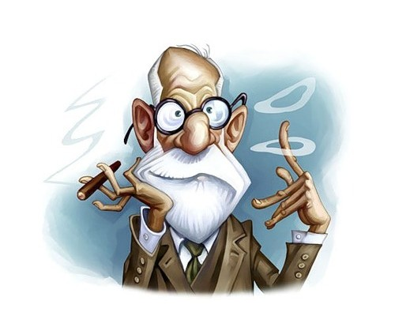
Hurdles to Understanding Psychosis
What triggers psychosis?
If it can start in the teens, begin in adulthood or be triggered by trauma, are there different kinds of psychosis?
There is no consensus on the etiology, development or treatment of psychosis.
Is it Genetics and Biology or Psychology?
Do I use Medication or Psychotherapy?
What’s a “psychotic break’?!
How does one “break” from reality?

Slide 7

Symptoms of Psychosis
Disorganized Symptoms
Negative Symptoms
5
4
Absence or loss of experience
Isolation; loss of responsiveness to people, events)
Decline in self-care, communicativeness; work or school performance; difficulty completing simple tasks
Grossly Disorganized or
Catatonic Behavior
Disorganized Speech
3
Positive Symptoms
Delusions
2
Hallucinations
1
Early Onset (EOP) vs Late Onset (LOP) vs Trauma Triggered Psychosis

Slide 8
Psychosis
Several Factors May Contribute to its Onset
Genetics
Trauma (cause or “trigger”?; form of disassociation?)
Substance Use
Underlying Neuro-Medical Disorders
Mental Health Disorders
  Mood Disordered SMIs (PTSD, MDD) VS Thought Disordered SMIs (Schizophrenias)
  Clients have “long-standing social and emotional difficulties that predate their psychosis by several years”; these “…may contribute to the content of their psychotic experience” -Harrow, Rattenbury, and Stole noted (1988) as did Rhodes and Jakes (2000).
  Cameron, N. (1943) noted that delusions form as a result of psychological and social isolation. The delusion becomes attached to a person or source, thereby reducing anxiety which, in turn, helps to maintain the importance of the delusion.

Slide 9
Hundreds of Therapy Approaches
Most fall into 1 of 3 broad categories
Psychological Models (Psychosocial)
Psychodynamic: unconscious forces shaped by childhood experiences
Behavioral: learning and factors within the person’s environment
Cognitive: ineffective, inaccurate or problematic thinking
Sociocultural: mental illness is the product of broad social and cultural forces
Biological/Neuro-genomic Models (Psychiatry)
Disordered behavior is caused by biological conditions, such as genetics, hormone levels, or changes in structural or neurotransmitter activity
3. Combo or Hybrid Models
    Diathesis-stress model: a predisposition to a given disorder combines with environmental stressors to trigger a psychological disorder
    Bio-psycho-social model: Takes into account predispositions, personal experience, and life circumstances

Slide 10
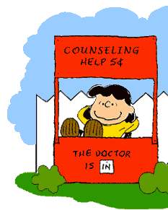
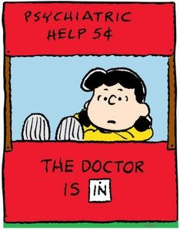
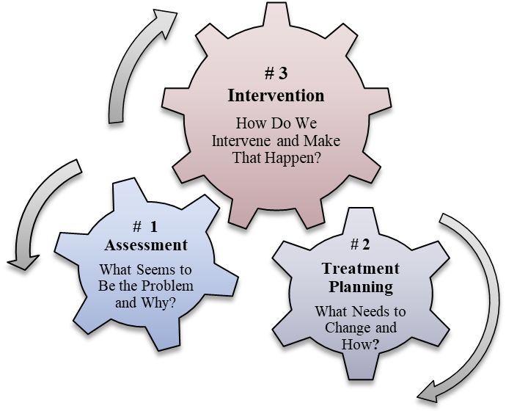
Why It Matters
Perspective drives
Assessment
Treatment Planning
Method of Intervention
Neuro-medical Perspective (Psychiatry)
Cognitive-behavioralPerspective
(Psychotherapy)
Disorders are caused by neuro-biomedical factors;
Controlling symptoms by adjusting biochemistry is the locus of treatment;
Primary intervention is psychopharmocology
Disorders are caused by psychosocial factors;
Changing belief structures to modify symptoms is the locus of treatment;
Primary intervention is ‘talk therapy’

Slide 11
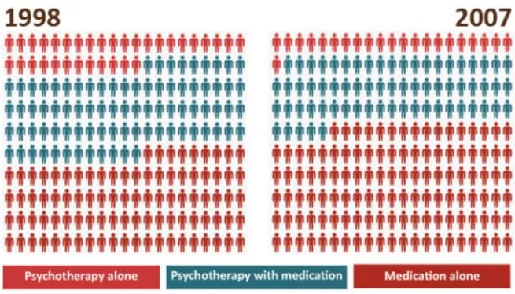
Reliance on Psychopharmacology
Decreased Use of Talk Therapy
Psychotherapy Only
Psychotherapy + Meds
Meds Only
Antidepressants, most commonly prescribed medication (2005);
Concurrent decrease in patients receiving psychological treatment
Patient preference, efficacy, and cost-efficacy for psychological treatment
Patience don’t obtain psychological treatment -McHughJ Clin Psychiatry. 2013 June ; 74(6): 595–602. doi:10.4088/JCP.12r07757

Slide 12
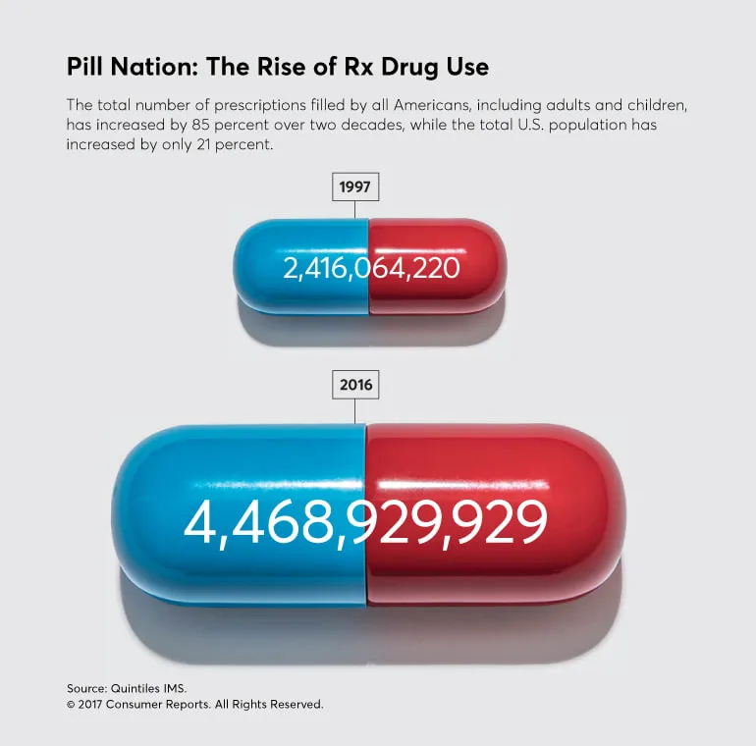
Trend Towards Reliance on Meds
85% increase
in scripts
20 years; pop 12%
Issues
  Some clients are simply shopping for meds: SA; ease of care; believe it’s better
  Medication reduces pain which can effect motivation for other forms of therapy
  Many clients who take meds, prefer talk therapy

Slide 13
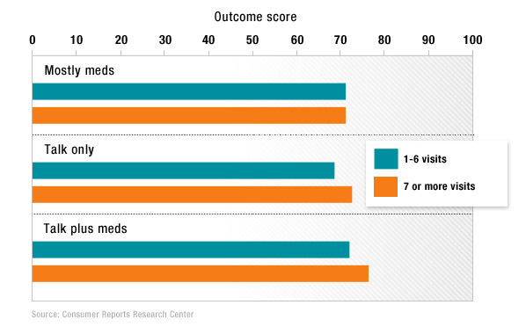
Meds, Talk, Talk + Meds

Slide 14
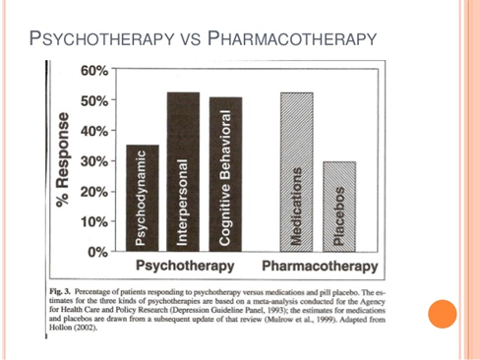
Psychotherapy vs Pharmacology

Slide 15
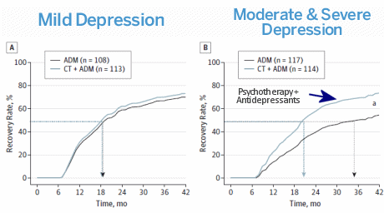
CT and Meds

Slide 16
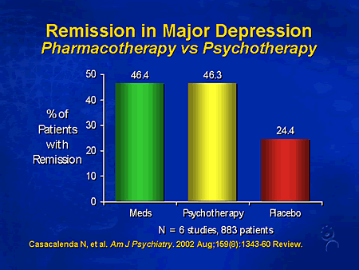
Remission Rate for MDD

Slide 17
Causation: Biology = Psychology?
1. MZ Twin concordance rates are NOT 100%; in utero conditions differ
Biological
3. If one can “recover” from psychosis than it must be a mental construct, not unlike cognitive distortions.
Psychosocial
1. Some common genetic markers for Autism, Bipolar, MDD, ADHD and Schizophrenia.
2. Many MZ Twin concordance rates as high as 45/55%
3. Structural changes in the brain.
2. Psychosocial factors are necessary preconditions; environment/learning?
        Sloppy Science: we simply do NOT know how one affects the other although they do
        Sloppy Lingo: “Psychological and Biological explanations are not merely different languages for the same phenomena….Psychological and Biological explanations are not explanations of the same things” – Gregory A. Miller; Distinguished Professor, Department of Psychology and the Department of Psychiatry and Biobehavioral Sciences at UCLA.
        Sloppy Thinking: perspectives NOT mutually exclusive, but can be at cross-purposes
Choice of Treatment
Use of Psychopharmacology
Assessment of Volition (degree to which one can exert control over the symptom; “Can’t” versus “Won’t”

Slide 18
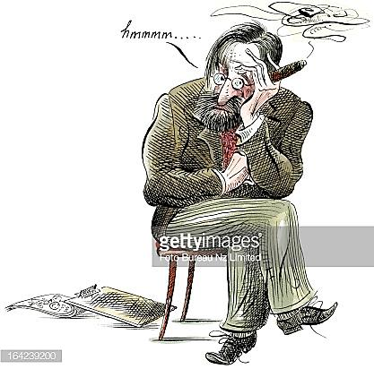
Treat the Psychological Component!
So, what’s a therapist to do?!!
Irrespective of their roots, symptoms acquire functional, adaptive value.
They acquire meaning, power and purpose to the individual and their relationship system.

Slide 19

There is nothing
as painful -or liberating,
as madness
- Demetrios Peratsakis

Slide 20
Mental illness is a myth,
whose function is to disguise and thus render more palatable
the bitter pill of moral conflicts in human relations.
— Thomas Szasz, Existential Psychiatrist

Slide 21
The experience and behavior that gets labeled schizophrenic is a special strategy that a person invents in order to live in an unlivable situation.
- R. D. Laing, Existential Psychiatrist

Slide 22
Psychosis . . . appears to us as the mental suicide
of an individual who does not believe himself adequate
to the demands of reality and to his own goals.
- Alfred Adler, Founding Theorist

Slide 23
Treating Delusions, Voices and Hallucinations
as Beliefs Structures and Metaphors

Slide 24
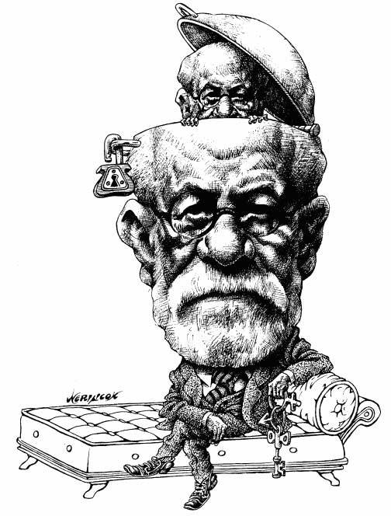
The Mind (Consciousness) is NOT the Brain
What is Consciousness?
Self-reflective; Self Concept and Self Ideal
Awareness of death and one’s own mortality (spirituality)
Ability for abstraction and to predict, make guesses and imagine the future
Ability for targeted deception
Ability to innovate (2+2=5)
Consciousness has Purpose!
“We create the reality in which we live.”
— James Turrel; Artist
Perception and/or Interpretation?

Slide 25

What is the Purpose of Consciousness?
The purpose of consciousness is to keep society together;
to predict, assess and effectively navigate complex social relationships.
- Social Intelligence Theory, Anthropology
The desire to feel belonging to others is the fundamental motive in man.
- Adlerian Pschology; Rudolf Dreikurs, 1949

Slide 26
Cognitive Behavioral Constructivism
& Social Constructionism
We behave and feel in a manner consistent with our beliefs. Believing is Seeing!”
Others react to our actions which, in turn, reaffirms our beliefs about how to act.
In part, we drive the behavior and emotions of others in order to obtain the very reactions that reaffirm our own belief systems.
Together, we create constructs and shared imaginings called patterns and structures, such as roles, rules, alliances, collusions, legacies and myths. These help us organize and operationalize social functions. These acquire purpose, meaning and power.
All psychological symptoms, syndromes and ‘presenting problems’ emerge as social constructs that must be unbalanced and redefined in order for change and growth to occur.

Slide 27
How Narratives Works
Narratives reinforce our preferred interpretation of reality
  thematic
  reaffirming
  reconcile self-concept and self-ideal
Membership groups create shared cognitive distortions
  amplify
  add solidity, resiliency and duration
  create intimacy, affinity and mutual dependency/co-dependency
  increase resistance to change
Dad’s ideas about women
(ie. OK to hit her)
Joe’s friend’s ideas about women
(ie. OK to hit her)
Son (Joe) ideas about women
(ie. OK to hit her)
“Shared” cognitive-distortions are sections of an inter-woven narrative or shared imagining.
For example: Dad, Joe, and Joe’s friend each hold a similar belief or cognitive-distortion about women

Slide 28
Types of Problem Interpretations
Cognitive Distortions
Mistaken (Erroneous) Beliefs: Bernard Shulman, MD (1973); 6 categories based on Adler’s work;
Irrational Beliefs: Neo-Adlerian Albert Ellis (REBT);
Cognitive Distortions: Neo-Freudians Aaron Beck and David Burns;
Shared Cognitive Distortions
    Pillari’s Family Myths
    Theology
    Nationalism
    Racism
    More Complex Forms
    Obsessions; Fanaticism
    Delusions, Voices and Hallucinations
    Addiction; Criminality
    Major Mood Disorders (MDD, Bi-Polar)
    Schizophrenias

Slide 29
Scaling Self-rhetoric
Mistaken Beliefs/
Shared Cognitive Distortions
Stereotypes
Prejudice
Over-valued Beliefs
Obsessions
Fanaticism
Delusions
Hallucinations
Distortions may be scaled by degree
Demetrios Peratsakis, LPC, ACS © 2020
Beliefs endure despite information to the contrary;
Delusions, Voices and Hallucinations are closed, feedback loops that continuously self-reinforce the thematic convictions (rumination);
The underlying intent or purpose of the internal discourse (delusion) is to reaffirm the individual’s safety protocols, or safe-guarding behavior,
While content contains the artifacts of the monologue, emotions convey the individual’s state of affairs at any given time; the ‘voices’ are merely ‘activating events’ or triggers.

Slide 30
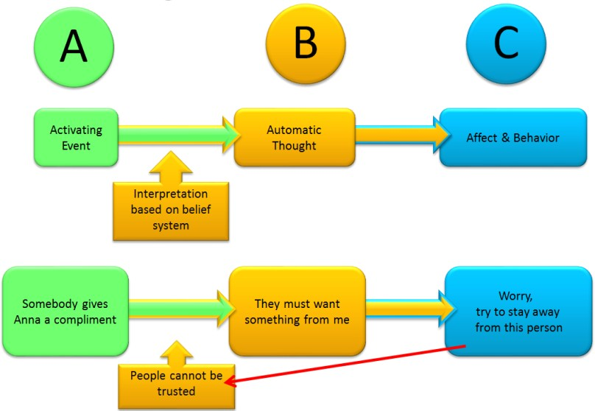
What Happens: CBT-p Model
Yulia Landa, PsyD, MS, Cognitive Behavioral Therapy for Psychosis (CBTp)

Slide 31
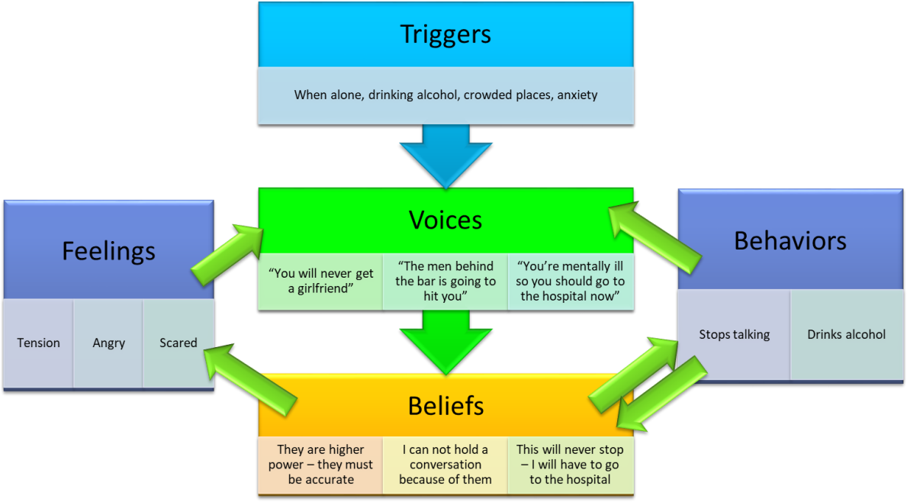
Typical CBT-p Sequence
Self-amplification
Yulia Landa, PsyD, MS, Cognitive Behavioral Therapy for Psychosis (CBTp)

Slide 32
Loss of Coherent Self Over Time
Self-concept narrative becomes fragmented, a collection of seemingly unrelated, at times contradictory, themes
The longer the illness, the greater the fragmentation, the steeper the climb toward normalcy
Extreme social withdrawal and isolation results in severe cognitive impairment
To mend, explore “who and what existed before the illness, and who and what endure during and after?” (S. Estroff, 1989). Three parts:
World-view: How I View the World (Demands of Life *)
Life is ; People are ; The world is ; How I View the World?; How I View Others?; How I View Men/Women?; How I View Love/Sex?
Self-concept: How I View Myself (including through the eyes of others)
I am ; I am not ; How I View Myself?
Valuation by others, achievement, and mastery over the demands of life (adulthood)
Self-ideal: The Perfection I strive to Become (self-actualization)
I should be ; and I should not be .; People should be ; Life should be . It is wrong to ; It is right to ______.
.

Slide 33
Preoccupational Themes in Psychotic Delusions*
Superior Achievement/Leadership: Preoccupation with grandiosity, aggrandizement or impressing others
Control/Dominance Aversion: Preoccupation with religiosity; avoiding others’ attempts to control or dominate them
Intimacy/Sexuality: Absence of an intimate relationship or conflict and jealousness, a belief that that one’s friend or lover has been unfaithful or betrayed them
Social Alienation/Inferiority Preoccupation with diminished sense of worth, persecution, or being an outsider
Annihilation Anxiety (preoccupation with death, injury or vulnerability) * Jakes, Rhodes and Issa, 2004
Category or Theme of Preoccupation
* Jakes, Rhodes and Issa, 2004
I am important and powerful, even though I don’t feel so
I am stronger, more righteous and better than others
Others betray you; don’t trust others
I don’t matter; Don’t trust others; Others will hurt you
I don’t matter
Re-affirming Message

Slide 34
Finding the Line of Movement*
Meaning gives purpose to behavior
Behavior has logic and is directed toward one of two goals:
  Self-actualization – adaptation and growth through connection, cooperation, and assertion with others (Social Interest)
  Self-protection - greater safety through aggression, manipulation, or avoidance*
  3. The behavior constitutes the line of movement toward those goals. *Robert Sherman (1991)
A
B
Outcome/Goal; what the behavior “accomplishes”. Look at reaction of others (ie. fear and withdrawal)*
Behavior or Emotion
(ie odd behavior)
Purpose of the Behavior
* Odd or bizarre behavior results in distancing and isolation by others.
That is it’s goal; the Goal of Psychosis: “Leave me alone!” “Don’t get too close to me!”

Slide 35
Socialization: Maturational Demands of Life
Adjustment and Adaptation to Change Across the Life Span
Trauma
Life Cycle
Life Tasks
Life Tasks
Work; Love; Friendship
(Alfred Adler)
Life-Cycle Changes
Normative and para-normative
developmental changes that
occur across the life-span
(Monica McGoldrick)
Trauma
Normative and para-normative hardships including Loss; Betrayal; and natural or manmade Disasters and Tragedies

Slide 36
Strategies for Life’s Demands
Socialization places continuous pressure on the need to adapt to change. Individuals that do not believe they are capable of successfully meeting the demands of life seek to avoid playing by the rules. Adler categorized these strategies as Neurosis, Sociopathology and Psychosis
Neurosis
“Yes, but…”
Exempt from the Rules: I know the rules but want to be excused from them.
Sociopathology
“F-You!”
Defy the Rules: I’m above the rules; they’re for chumps!
Psychosis
“No!”
Negate the Rules:
I will create my own rules so that I do not fail.
The Goal is ostracism; to be left alone and isolated. Expulsion.
The Goal is to feel that one has got over, or got even.
The Goal is to escape judgment or to be judged less harshly.
Tip #1: Self-esteem (Worth) = Self-ideal – Self-concept
Tip #2: The more extreme the behavior, the lower the Self-esteem
Tip #3: To increase Self-esteem, reduce isolation/increase Social Interest

Slide 37
We are social beings.
When we withdraw, isolate or are cutoff from social activation
it increases tension and mars our capacity to engage.
It is an aggressive form of avoidance.
The isolation is at once stress reducing and tension increasing.
See Bowen’s “Emotional Cut-off”

Slide 38
Neurosis vs Psychosis
Background
Assuming that organicity has been ruled out, Adlerian Psychology sees neurosis and psychosis as purposive syndromes created by the individual to protect themselves from the risk of failure at the demands of life. This, remarkable perspective normalizes our understanding of these conditions as complex, safe-guarding strategies whose onset may be facilitated by such factors as stress, drug use, biomedical conditions or trauma, but not determined by them. They protect a fragile sense of self wherein the individual does not believe they are capable of successfully meeting the demands of life and either seek to be exempted from the rules (neurosis), defy the rules (sociopathology), or negate the rules and substitute ones of their own creation (psychosis).
Each takes a very different path:
  Neurosis, is defined as a “Yes, but…” condition. The individual recognizes the requirements and demands of living (“Yes, I see what is required of me…”) but seeks an exemption (“but I can’t or don’t want to do it because…”) through various pretexts, including the development of symptoms. Viewing behavior from this perspective provides the clinician with remarkable clarity into the control and power issue that earmark such passive-aggressive conditions as addiction, depression or eating disorders. A more aggressive stance is taken by those we term “sociopathic”, who acknowledge the demands of life but choose to defy them as a false measure of their own superiority.

Slide 39
Neurosis vs Psychosis
Background
Psychosis, is defined as a “No!”, an abject refusal to participate in the demands of life. The psychotic negates the common sense of the community and plays by their own rule-book. They escape into a world of their own creation, continuously reinforcing its rules, roles and outcomes through delusions and hallucinations. The individual does not believe themselves adequate to the demands of reality and have developed a means by which to retreat from it.
Neurosis and psychosis both mask a perceived sense of inadequacy. The feelings of vulnerably and worthless are real, as is the acute suffering the individual experiences. It is, in fact, this very experience that adds legitimacy to the individual’s plight and ties others into excusing or enabling their conduct. Their sense of guilt, shame and sorrow, as well as their constant experience of dread and fear of exposure, fuel their sense of inadequacy and while “unwelcome” preserves their sense of control.

Slide 40
The Purpose of Delusions, Voices and Hallucinations
Metaphors
Reaffirm Belief Structures
Amplify Power and Prestige
Self-guarding Measures; stress reducers
Chaotic behavior is a form of distraction from the experience of pain
Disorganized behavior is a method of controlling others
Avoid Responsibility
Bizarre behavior assures isolation

Slide 41
The goal of psychosis is to be left alone and, thereby, to escape responsibility for meeting the demands of life.
The isolation it creates limits the individual’s ability to belong with others in a meaningful way.
This, in itself, deepens one’s inability to meet these demands and the the individual becomes trapped in a world of their own creation.

Slide 43

Treatment

Slide 44
Common Treatment Methodologies
Psychotherapy
Medication Management: typical (first generation; block dopamine) and atypical (second generation; block dopamine/affect serotonin levels) antipsychotics, including
aripiprazole (Abilify), asenapine (Saphris), cariprazine (Vraylar), clozapine (Clozaril),
lurasidone (Latuda), olanzapine (Zyprexa), quetiapine (Seroquel), risperidone (Risperdal)
ziprasidone (Geodon)
Alt-therapies: Ayurvedic, Music and Aroma therapies
Electroconvulsive Therapy (ECT) and Deep Brain Stimulation
PACT or Intensive Community Treatment Team approaches that bundle
Case management
Family support and education
Psychotherapy
Medication management
Supported education and employment
Peer support
Socialization activities such as Mental Health Support and Psychosocial Rehabilitation Day Programs

Slide 45
The Initial Consultation
STEP 1: Global Assessment
Standard instrument (ie DLA-20) or core realms of functioning:
Relationship System (genogram not history)
Unresolved Trauma
Open Discord/Power Struggles/Abuse
Drug Use and Addiction
Overall social functioning with Love/Sexual Relations, Work, Friendships
STEP 2: Rule Out*
Exclude the possibility of a neurobiomedical condition
Psychosis: Assess for extent of Cognitive Impairment
STEP 3: Explore the PP or Symptom
Track the Sequence of beliefs and interpersonal transactions surrounding the Presenting Problem (PP), Identified Patient (IP) or Symptom(s);
Test the rigidity of the belief system, unbalance existing convictions and introduce new possibilities;
Return to the Presenting Problem/Contracting, refocus on the goal of treatment and solidify agreement to work. Psychosis work can be long term; change is incremental

Slide 46
Overview of the Treatment Process
STEP 4: Goals
Cognitive Restructuring/Rebuilding the Narrative
Psychosis: Habilitate/Rehabilitate Skill Deficits
Lift Depression*
  Resolve open discord and power-struggles
  Heal trauma’s guilt, anger and shame
Build Self-worth
STEP 5: Relapse Work and Recovery and Supports
Psychosocial and Socialization activities for decreasing isolation, improving ADLs, and increasing;
Integration in Meaningful Activity
Relationship Building (old and new)

Slide 47
Considerations for Treating Psychosis
Duration of treatment (change may be slow and incremental)
Dosage
Avoid confrontations
Expect emotions to escalate
  train emotional regulation (revise faulty strategies such as rumination and physical agitation)
  stress intensifies symptoms (it’s an important barometer of duress)
Accept the client’s need to portray an attitude of superiority
Use Cognitive Restructuring
  modify meaning to modify messages
  modify experience to restructure cognition
  use delusions, voices and hallucinations to restructure narrative
The greatest impediment to change is the clinician’s own fears

Slide 48
Considerations for Treating Psychosis
8. Socialization is critical!
Be realistic; cognitive impairment and social skill deficits may be extensive
One may have missed a great number of opportunities to experiment with societal demands and experiences.
One may have lost immeasurable opportunities to fine-tune the nuances of social expression and interaction.
Longer, more profound isolation or social withdrawing behavior results in
  Cognitive impairment
  Social skills deficits
ADL skill development essential (Habilitation over Re-habilitation)
Increase Social Integration: increase involvement in communal life, friendship, work and love. (Love/Intimacy + Work/School + Socialization = Self-Worth)

Slide 49
Session Format
  Stay Structured (reduces anxiety; adds predictability, models norm, improves cognitive skills)
  Check In
    Joining; connect, reaffirm and strengthen therapeutic alliance
    Check on mood and symptoms; scale mood and symptoms
    Bridge from last session
  Plan Jointly
    Agree on session agenda and order of discussion
    Review homework, tasks or assignments (if applicable)
  Explore
    Examine progress, explore challenges, re-evaluate therapeutic alliance
    Nibble at edges; mildly suggest/introduce new possibilities; reframe; create new symptoms
    Connect session discussion to 1) prior session; next session; 3) overall treatment plan
  Experiment (to change meaning, change experience)
  Button-up
      Review session
      Make plans for next session
      Temp Check/Feedback: client’s view of session; mood check/scaling; helpful/less helpful
      Assign homework or tasks (if appropriate)
      Cautions to move slow (set-backs are common and routine)
      Reaffirm client’s courage and dedication; express appreciation for working relationship

Slide 50
Rule Out Underlying Medical Conditions
Hormonal, neurochemical, structural injuries or irregularities of the body and brain
    Congenital Brain Damage (CBD): genetic (pre-birth) or birth trauma
    Acquired Brain Injury (ABI)/Neurological and Medical Illnesses: i.e.. stroke, tumors, aneurysms, thyroid disease, cancer, vitamin D deficiency, poisoning, exposure to toxic substances, infection, choking, complications due to alcoholism, substance misuse or medications.
    Traumatic Brain Injury (TBI): head/skull injury to brain (accidents, sports injuries, falls, violence)
  What to look for:
  Evidence of Progressive Decline in Cognitive Performance
  Selectivity of the Impairment
  Attitude toward Impairment by Caregivers
  “The Miracle Question”
  Things to Consider
Formal Testing; Coordination with PCP or other primary healthcare providers
“Can Do” vs “Can’t Do” ; “Can’t Do” vs “Wont Do”
Institutional Behavior
Chronic Duress/Severe Emotional Distress
Symptom Purpose and Intent*

Slide 51
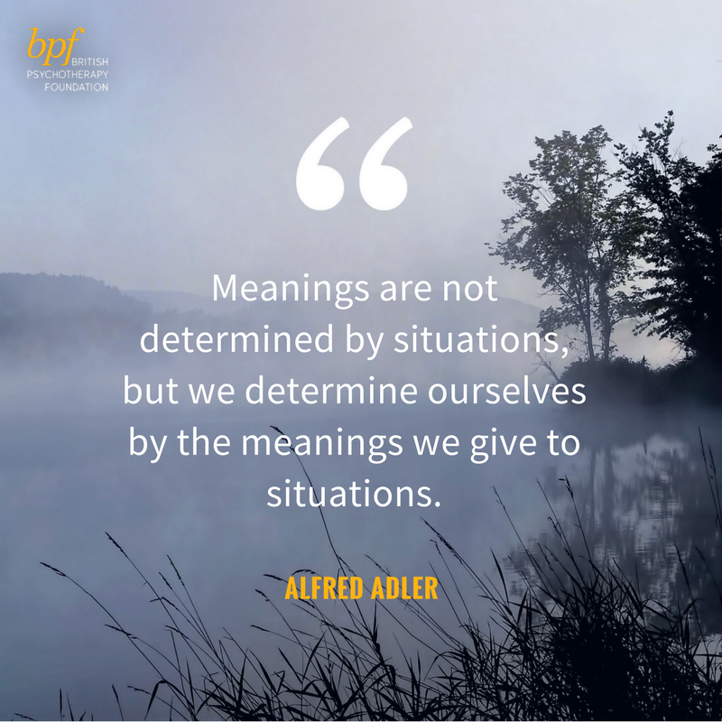
What Life Should Mean to You (1937), p. 14
Meaning Drives Interpretation

Slide 52
Changing the Narrative
Narrative
(Life Style)
Voices
Triggers/
AT
Messages
  Personification Modify the Messengers or Voices
Message
Massaging the Message(s)
  Triggers: Modify Experience
  Modify the Activating Events (people, places, or things) or
  their Sequence

Slide 53

1) Personifying the Messenger
  Adding Flesh to the Bones
  Details make it Real!
  Is the voice happy, sad or scary?
  Does it criticize, threaten, advise or comfort? What is it telling you?
  Describe it? What is it’s tone, pitch, volume, texture; male/female, gay/ straight, single/married, dressed?
  What famous person, good or evil, living or dead, does the “ghost” remind you of?
  Pretend you know them; who is it?
  What is different when the voice is not present? Does it ever change?
  If the voice said something new, never said before, what would that be?
  If you could talk back, what would you say? When the voice goes away, where is it?
  Personification
  Use of Externalization and Projective Technique as well as Expressive Arts to concretize the messenger(s) and then change its features
  (Empty Chair, Fantasy, Guided Imagery, My Life Story, My Position Map, Free Association, Psychodrama, Art, Dance, Sculpting, Music)

Slide 54
2) Massaging the Message
Modify the meaning attached to people, presenting problems and events by exploring the beliefs, patterns or sequences of interaction surrounding them and softly introducing new possibilities:
Explore
    rigidity and inflexibility in rules, expectations and outlook
    conflict (guilt and shame) created between ideal and actual performance
    extremes such as “Must” and “Should”, “Never” and “Always”
Build the Narrative/Connect the Dots: craft a narrative with the client that connects all the seemingly unconnected beliefs, nodal events, persons, emotions and related stories
  Experimentation to modify or manipulate the narrative/experience.
  Socratic dialogue: introduce doubt, pose new possibilities, and undermine or attack the underlying logic
  Re-enactment: role-play, behavior rehearsal or active re-enactment
  Projective Technique: use fantasy, imagery, free association, early recollections, empty chair, externalization, visualization, sculpting, writing, and psychodrama.
Re-Build the Narrative as a new central story or over-arching theme
Brainstorm alternative scenarios, themes, stories and interpretations
Develop an alternative account that reframes experiences as acceptable and understandable
Chi (centering) training: mindfulness, meditation, relaxed breathing/progressive relaxation, yoga, martial arts, games, art, journaling, behavior rehearsal or skills training to reduce fragmentation and anxiety, still panic, integrate body and mind and improve focus

Slide 55
  Massaging the Message
  Change the transactional pattern or sequence of behaviors surrounding the symptom or problem
  Change the role(s), rule or way of being organized
Trace beliefs related to a) self, b) others; and c) preoccupations/fears and vulnerabilities in the family lineage/genogram; i.e. “Whose rule is that?”
“Spit in the Client’s Soup” to undermine the narrative by interpreting the motive or making its covert intent, overt, then frustrate its inherent sense of “nobility” or personal gain
Examine “Pluses” and “Minuses” to broaden narrow perspectives
Examine how the narrative is used to reaffirm loyalty to family
Examine how it reaffirms convictions; what does “breaking” the rule means
    Examine the Pros and Cons; assess the negative consequences and scale or assess its cost
    Weaken a strongly held by pitting it against an equally strong opposite belief
    Point to disparities and logical inconsistencies, especially between beliefs or values
    Inflate, exaggerate or dramatize the belief to make it extreme, trivial or silly
    Create or reframe a narrative or story that puts the situation in a more favorable context (reframing)
    Examine the family rule or “voice” behind the assumption and attend to the loyalty issues
    Use of the “Miracle Question”, Time Travel or Time-outs to imagine and explore freedom from AT

Slide 56
3) Modify Experience: Sequences and Triggers
Create a new symptom (i.e.. “I am also concerned about ________; when did you first notice her doing that?”)
Switch to a more manageable symptom (one that is behavioral and can be scaled; i.e.. chores vs attitude)
I.P. another family member (create a new symptom-bearer or sub-group; i.e.. “the kids”, “the boys”)
I.P. a relationship (“the relationship makes her depressed”)
Push for recoil through paradoxical intention (caution!)
“Spitting in the Soup” –make the covert intent, overt, then frustrate its inherent sense of “nobility”
Increase symptom intensity by describing worse-case scenario or what could happen if things went unchecked
Add, remove or reverse the order of the steps (having the symptom come first)
Remove or add a new member to the loop
Inflate/deflate the intensity of the symptom or pattern
Change the frequency or rate of the symptom or pattern
Change the duration of the symptom or pattern
Change the time (hour/time of day/week/month/year) of the symptom or pattern
Change the location (in the world or body) of the symptom/pattern
Perform the symptom without the pattern; short-circuiting
Change some quality of the symptom or pattern
Perform the pattern without the symptom
Change the sequence of the elements in the pattern
Interrupt or prevent the pattern from occurring
Add (at least) one new element to the pattern
Break up any previously whole elements into smaller elements; cut sequences into smaller steps
Link the symptoms or pattern to another pattern or goal
Reframe or re-label the meaning of the symptom
Point to disparities and create cognitive dissonance
Disengage the power-play that fuels the symptom and tap the underlying anger
Surface Guilt and Shame and mobilize the underlying anger and desire for revenge
Note: 1-4, Minuchin/Fishman; 5-6, 22, 23, Adler; 8-21, O’Hanlon; 7, 25, 26, Peratsakis
Pattern or element may represent a concrete behavior, emotion, or family member

Slide 57

TRAUMA
There is no greater privilege, then to share in the suffering of another!

Slide 58
Working with Trauma
Anger
Sadness
Fear
Trauma results in a mix of feelings and thoughts
called depression and anxiety
Guilt
Depression/Anxiety
Shame
© 2014 Demetrios Peratsakis, LPC, ACS,
  Anxiety: dread; perceived sense of vulnerability; preoccupation with safety; future oriented
  Depression: sorrow + hurt; result of a significant loss or becoming the victim of disaster or a betrayal by a trusted person or loved one; spectrum disorder; past oriented. Evolution advantage: reaffirms social bonds/protection.
  GASh : depression-anxiety are fueled by feelings of Anger, Guilt and Shame

Slide 59
Targeted Treatment Processes
1
3
Work on Guilt and Shame
Depression and Anxiety lift
Shame
2
Tap into Anger
Sadness
Guilt
Fear
Anger
1. The guilt and shame must be reconciled and their underlying (cognitive) distortions restructured
3. Self-worth must be improved by increasing
confidence and prestige through social
involvement that is purposeful and meaningful.
Empowerment begins as self-worth improves.
The anger that accompanies the hurt must be validated and given voice.
As the therapist taps into the anger, the depression will lift.
The simple rule is: where there is depression, there is also anger.
(When you see “Sad”, look for the “Mad”; to reduce the “Sad”, tap into the “Mad”)
- Demetrios Peratsakis, LPC, ACS © 2015
59

Slide 60
Keys to Healing Trauma
  The source of the injury (Loss; Betrayal; Natural/Manmade Disaster or Tragedy) affects the type of psychological damage and preoccupation (replacement; revenge; safety)
  Challenge the manner in which the pain is distracted or suppressed.
  “Enter Anger and Blame, Exit Guilt and Shame” (GASh = Guilt, Anger and Shame)
  The goal of psychosis is isolation, which deepens trauma; need to increase social belongingness
  As a rule,
      Review need for meds (to modulate mood extremes) and safety plan
      End and repair discord, conflicts or power-struggles and cut-offs; increase socialization activities
      Give voice to the hurt and anger; tell the story, then re-narrate it
      Work through self-pity, passivity and victimhood (guilt, shame, self-blame)
      (Symbolically) quench the thirst for revenge
      Enhance Self-worth through competencies and things that promote social well-being
      Work toward Forgiveness and Redemption; forgiveness comes only with genuine remorse

Slide 61
If you talk to God, you are praying.
If God talks to you, you have Schizophrenia
— Thomas Szasz, Existential Psychiatrist

Slide 62
A neurotic is a man who builds a castle in the air.
A psychotic is the man who lives in it.
A psychiatrist is the man who collects the rent.
- Jerome Lawrence, Playwright

Slide 63


Slide 64
References
Adler, A., The Individual Psychology of Alfred Adler, H. L. Ansbacher and R. R. Ansbacher (Eds.) (Harper Torchbooks, NY 1956
Adler, A., The Practice and Theory of Individual Psychology, translated by P. Radin (Routledge & Kegan Paul, London 1925; revised edition 1929, & reprints
Cognitive Restructuring: Gladding, Samuel. Counseling: A Comprehensive Review. 6th. Columbus: Pearson Education Inc., 2009.
Conte, Christian. Advanced Techniques for Counseling and Psychotherapy, Springer Publishng, New York
Dinkmeyer, D., Pew, W. and Dinkmeyer, D. Jr. 1979. Adlerian Counseling and Psychotherapy, Monterey, CA: Brooks/Cole.
Dreikurs, R., Gould, S. and Corsini, R. 1974. Family Council, Chicago: Henry Regnery.
Emotional Regulation; Karen Livingstone, Sean Harper, and David Gillanders (2009)
Erford, Bradley T., 2015, 2010. Forty Techniques Every Therapist Should Know, 2nd edition, Merrill Counseling Series, Pearson
Hope D.A.; Burns J.A.; Hyes S.A.; Herbert J.D.; Warner M.D. (2010). "Automatic thoughts and cognitive restructuring in cbt group therapy for social anxiety disorder". Cognitive Therapy Research. 34: 1–12.
Manual For Life Style Assessment, Bernard H. Shulman and Harold H. Mosak; Routledge, 1988
Narrative CBT for Psychosis, John Rhodes and Simon Jakes; Routledge, 2009
Richard Leakey; The Origin Of Humankind, Master’s Series, Orion Publishing, 2013 (1994)
Sherman, R., Oresky, P., Rountree, Y. 1991. Solving Problems in Couples and Family Therapy, Brunner/Mazel. New York
Sherman, R., Fredman, N., 1986. Handbook of Structured Techniques in Marriage & Family Therapy, Brunner/Mazel, NY
Sherman, R., Dinkmeyer, D.,1987. Adlerian Family Therapy, Brunner/Mazel, New York

Slide 65
Supplemental Materials

Slide 66
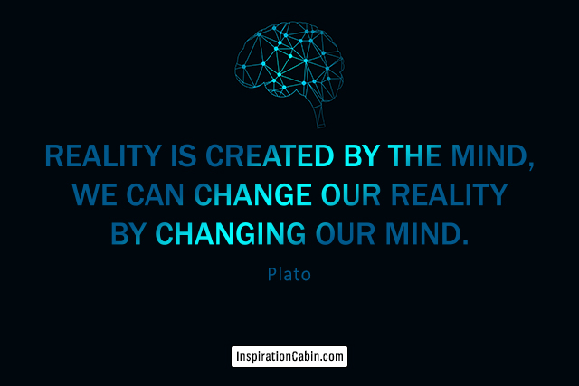
Cognitive Restructuring

Slide 67
a) Unbalancing Beliefs
        Change occurs when the meaning, power or purpose of a belief is modified
The most common method for countering negative, self-limiting and counter-productive thoughts is to use Critical Reasoning or a process known as Cognitive Restructuring (Doyle, 1998; Hope, 2010) to
  “unbalance” and redefine the belief structure. There are four generally recognized steps:
  Identify problematic images or mental activity that occur as a response to some trigger, like an action or event. These "automatic thoughts" (ATs) convey negative assumptions and predictions about the self, others, the world and ways to belong and function socially;
  Isolate the distorted, irrational, or mistaken assumption that underlies the automatic thought;
  Use a Socratic dialogue (through interviewing, role-play or imagery) to introduce doubt, pose new possibilities, and undermine or attack its underlying logic (“unbalancing”). Examples include,
      Examine the Pros and Cons; assess the negative consequences and scale or assess its cost
    Weaken a strongly held belief by pitting it against an equally strong opposite belief
    Point to disparities and logical inconsistencies, especially between beliefs or values
    Inflate, exaggerate or dramatize the belief to make it extreme, trivial or silly
    Create or reframe a narrative or story that puts the situation in a more favorable context (reframing)
    Examine the family rule or “voice” behind the assumption and attend to the loyalty issues
    Use of the “Miracle Question”, Time Travel or Time-outs to imagine and explore freedom from AT
  Develop, reframe or re-narrate a rational rebuttal to the automatic thought

Slide 68
Thought Stopping: short-circuiting negative ideation; Self-Talk: positive self-affirmation
“Spitting in the Soup”: undermine the narrative by interpreting the motive or making its covert intent, overt, then frustrate its inherent sense of “nobility” or personal gain
What if this wasn’t so? Explore a scenario in which the idea was no longer true or applicable. Explore “worse-case” scenarios; “What’s the worst thing that would happen if…?”
Empty Chair: externalize the belief as an opponent or “demon”, then encourage rebellion against it
Use imagery, visualization, role-play, sculpting, drawing or other projective techniques to gain perspective, elongate the narrative or directly manipulate some part of it
Use free association, analysis of dreams, early recollections, or fantasy exercises to undermine the power of the belief or myth or to foster imagery-based exposure
Mindfulness meditation, relaxed breathing, yoga or progressive relaxation to reduce fragmentation and anxiety, still panic, integrate body and mind and improve focus
Activity Scheduling to intentionally experience activities typically avoided
Graded Exposure or desensitization to feared or toxic experience, increasing comfort
Successive Approximation or breaking large steps into smaller ones
Journaling or thought record of moods and/or thoughts, especially noting the time, the extent of the mood or thought, and what led to it
Skills Training (i.e.. assertiveness, communication, social skills) designed to remedy skills deficits through modeling, coaching and direct instruction, and role-play training
Flagging the Minefield ((Sklare, 2005) or anticipating and preparing for relapse and pitfalls

Slide 69
Unbalancing the Symptom
Change occurs when the meaning, power or purpose of the P.P. is modified
It is important to continually test the rigidity of the beliefs surrounding the Presenting Problem and the Identified Patient. Introducing new possibilities, reframing and resequencing existing interactional patterns or re-organizing roles, rules and organizational structures or patterns increases flexibility and expands the client’s perspective and ability to interpret -and then respond, in a different way.
    History of Presenting Problem (PP): major nodal events surrounding the problem onset, including trauma, betrayals, losses, anniversary dates and major transitional events such as retirement, divorce, graduations or beginning school, leaving home, et al. The difficulties adapting to change, hardships or periods of heightened stress often foster the creation of problematic or symptomatic behavior patterns. The symptom onset often clues you in on the possible purpose the symptom or problem serves.
    Pattern of Interaction This refers to the sequence of behavior surrounding the Presenting Problem or problem occurrence (who does what, when and where). This repetitive, interactional loop maintains the presenting problem and highlights who participates in maintaining it. Manipulating its components, introduces new possibilities and fosters a revised perspective on the problem, its etiology and purpose.

Slide 70
How Psychological Symptoms Form
Behaviors, feelings and thoughts surrounding the presenting problem (PP) or symptom harden over time becoming interactional patterns that acquire history with well-defined roles and rules and expectations.
In essence, a pattern or “structure” around which communication and membership is organized, boundaries defined, and power expressed and reconciled.
In particular, the emerging pattern fulfills the mutual purposes of its participants, providing a vehicle for communication and attachment and the open expression of love, anger, trust, and responsibility.
Underlying this, we often find a prolonged and deeply embedded power-struggle, fueled by concomitant feelings of hopelessness, resentment and rage. It is often passive-aggressive.

Slide 71
  Symptoms are convictions maintained by sequences of thoughts and behaviors, by the individual as well as their relationship system. Interrupting these will necessarily alter the symptom and directly challenge its rigidity and inevitability.
Shared Cognitive Distortions
Father
Mother
D1
S1
S2
Shared Distortion
Shared values and opinions, represented by the overlapping shaded areas, mirror a part of each member’s belief structures thereby reaffirming (concretizing) their ‘truth’ and purpose.

Slide 72
Introducing New Possibilities
Create a new symptom (i.e.. “I am also concerned about ________; when did you first notice her doing that?”)
Switch to a more manageable symptom (one that is behavioral and can be scaled; i.e.. chores vs attitude)
I.P. another family member (create a new symptom-bearer or sub-group; i.e.. “the kids”, “the boys”)
I.P. a relationship (“the relationship makes her depressed”)
Push for recoil through paradoxical intention (caution!)
“Spitting in the Soup” –make the covert intent, overt, then frustrate its inherent sense of “nobility”
Increase symptom intensity by describing worse-case scenario or what could happen if things went unchecked
Add, remove or reverse the order of the steps (having the symptom come first)
Remove or add a new member to the loop
Inflate/deflate the intensity of the symptom or pattern
Change the frequency or rate of the symptom or pattern
Change the duration of the symptom or pattern
Change the time (hour/time of day/week/month/year) of the symptom or pattern
Change the location (in the world or body) of the symptom/pattern
Perform the symptom without the pattern; short-circuiting
Change some quality of the symptom or pattern
Perform the pattern without the symptom
Change the sequence of the elements in the pattern
Interrupt or prevent the pattern from occurring
Add (at least) one new element to the pattern
Break up any previously whole elements into smaller elements; cut sequences into smaller steps
Link the symptoms or pattern to another pattern or goal
Reframe or re-label the meaning of the symptom
Point to disparities and create cognitive dissonance
Disengage the power-play that fuels the symptom and tap the underlying anger
Surface Guilt and Shame and mobilize the underlying anger and desire for revenge
Note: 1-4, Minuchin/Fishman; 5-6, 22, 23, Adler; 8-21, O’Hanlon; 7, 25, 26, Peratsakis
Pattern or element may represent a concrete behavior, emotion, or family member

Slide 73
c) Unbalancing Structure & Organization
Change occurs when the meaning, power or purpose of transactions are modified
Social structures, includes rules, roles, sub-systems, alliances and collusions exist through shared convictions and belief systems. These organize function and interaction and contribute to long-standing beliefs about the system, its membership and guidelines for interacting; modifying these, change perspective and, in turn, interpretation, opinion and prediction. Restructuring intwilleraction, modifies reality. Below are some common tactics.
Disengage and redirect existing power-plays; implement “truce” and reconcile unresolved conflict and cut-offs. Approach the conflict through sequential interpretations (same problem highlighted through different points of view) and track the sequence of interactive behavior (“…and then what happens?”) until the loop comes to a close.
  Re-enact problem scenarios or use role-play and sculpting to illuminate family or relationship structures and roles, then rescript their narratives and practice revisions
  Separate people who are sitting together
  Block interruptions or inappropriate requests for confirmation, to control or to censor
  Discourage use of one member as a repository for another’s memories, feelings or thoughts
  Approve descriptions of competence. Encourage members to reward competence in session
  Tell one member to help another to change
  If one controls, confront another for encouraging their dominance
  Direct individuals to speak to each other

Slide 74
Use of ‘empty chair’ to represent absent members, hidden rules, secrets or taboos; manipulate and use space, to connect and disconnect, to show closeness or distance; use props and furniture (concrete reminders) to illustrate relational components
Unbalance alliances, coalitions and collusions; fashion new ones, or temporarily join a subsystem, to adjust the balance of power and improve communication patterns
Establish, strengthen, or weaken boundaries; empower the executive sub-system
I-Messages; increase differentiation of self, personal space and independence of members
Block inappropriate roles or role behavior; model appropriate behavior. Prescribe role reversals; revise roles, strengthen existing natural roles, or assign new ones
Temporarily shift power and authority structure: Queen for a Day; King of the Castle
Provide more structure in a chaotic organization; reduce rigidity in an inflexible structure
Take a “one-down” position to force the client or family into the “one-up”
Create celebrations, honorifics or exorcisms to modify, up or down, the power surrounding a member; introduce new customs, rituals, practices or ordeals
Hold an exorcism or funerary rite for the old belief, family myth or legend; create a ritual or assignment to be practiced that mirrors the new belief. Create a new point in time (“then” versus” from here forward”) or establish a “truce” for moving forward

Slide 75
Use of a Genogram, Socio-map or Family Floor Plan to examine truisms and taboos
Establish a Family Council so that grievances and supports can be materialized
Spread out a symptomatic role among all family members to expose the family secret or remove or rotate the symptomatic member from the scapegoat position
Introduce other clients or families to session and foster interfamilial organization
Time-travel or regrow the client or family from scratch and have them “act as if” they are the person or persons they wish to be
Use Behavior Rehearsal; “Acting As If”; Guided Imagery; and Fantasy techniques to work on self-empowerment and explore fears and dreads to success and failure
Work through issues of Guilt, Anger and Shame (GASh); focus on desires and acts of revenge and move toward acts of forgiveness and redemption
Connect with each member and affirm their value; create Caring Days,
Identify and validate strengths; encourage recognition by the family of each other through celebrations, boasting, awards and acts of praise. Promote “New Talk”
Refer clients to additional educational materials and resources, experts and trainers
Assign tasks and functions based on abilities. “What is she good at?”
Help members with assertiveness and improve mediation and negotiation skills. Curtail acts of aggression, back-biting, complaining, rivalry, subterfuge and revenge

Slide 76
Identify choices and make joint decisions. “Doom” clients to success by setting small, common workable goals and anticipating obstacles, sabotage and possible failure
Identify and emphasize positive changes and movement; examine what worked
Reframe negative meanings and negatively charged events
Recall incidents that worked successfully in the past or solutions from TV, Movies or others
Increase self-esteem, personal worth and mutual respect and valuation; connect in a meaningful way. Improve self-image through boasting and self-esteem worksheets
Challenge underlying “nobility” of self-defeating behaviors (“Spitting in Client’s Soup”)
Use paradox (with caution) to prescribe existing roles, rules, and patterns of interaction
Add or detract family members from session
Bring other families into session and pair subsystems, foster interfamily competitions or use members in similar roles as co-therapists
Place the symptom on vacation or write a prescription to schedule it at given times
Have the clients experience each other in a different, fun, way or varied venue
Explore what each member is willing to do to alleviate the current problem, change the rule, alter the belief, or help create, through a change in their own behavior, a new interactional paradigm

Slide 77
Use of the Therapeutic Alliance to foster change. Few components of the therapy process are as potentially transformational as the relationship that, clients have with the therapist. By continuously demonstrating acceptance and positive regard, active listening, and support and encouragement, the therapist provides a safe milieu for the experimentation and trial of new ways of thinking and behaving. Moreover, a seasoned therapist may use their own way of being, their own style of interacting with the client to both frustrate and promote behavior change. Even by simply responding in a manner that is different then what is expected -or routinely experienced with others, the therapist has created the opportunity for change. Finding a balance between support and confrontation, at times even provocation, is an important attribute of the experienced therapist. So, too, is the ability to disengage and redirect the power-struggles that arise between the therapist and client and that are common to the therapeutic relationship. In this regard, the greatest agent of change is often the clinician, themselves.

